Slide 1



Étude Canadienne sur les services d’avortement (CAPS)
Regina Renner, MD, MPH, FRCSC, FACOG, professeure agrégée de clinique Department of Obstetrics and Gynaecology, University of British Columbia
regina.renner@ubc.ca
Notes:
Clinical practice mainly in Nanaimo
CAPS is a 4 year CIHR funded study with the ultimate goal to improve women’s access to high quality abortion care services.

Slide 2
INTRODUCTION

Slide 3
L’ACCÈS À L’AVORTEMENT AU CANADA
Limité pour les patientes vivant dans les communautés rurales/éloignées
Certaines patientes parcourent de longues distances pour accéder à l'avortement
Entraîne des retards dans les soins et avortement à un âge gestationnel plus avancé
Norman WV, Guilbert E, et al. Canadian Family Physician 2016
Sethna C, Doull M. Spatial disparities and travel to freestanding abortion clinics in Canada. Women’s Studies International Forum 2013

Slide 4
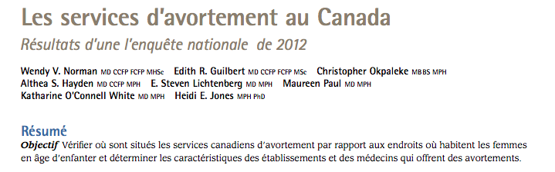

Notes:
First-trimester abortion is a common medical procedure in Canada. Geography is a substantial barrier to abortion access in Canada, and national statistics are incomplete. This study aimed to understand the current availability and practice of medical abortion (MA).
• Medical abortion represented a very small proportion (3.8%) of first-trimester abortions performed in Canada.
Facilities reporting first trimester MA were unevenly distributed across Canada (none were in the Atlantic provinces and 60.0% were in Quebec or British Columbia).
• We further leant that more than half of current MA providers in Canada are family physicians, and more than 90% of MAs are provided in private offices or freestanding clinics.

Slide 5
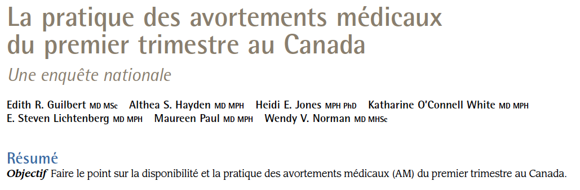
Notes:
First-trimester abortion is a common medical procedure in Canada. Geography is a substantial barrier to abortion access in Canada, and national statistics are incomplete. This study aimed to understand the current availability and practice of medical abortion (MA).
• Medical abortion represented a very small proportion (3.8%) of first-trimester abortions performed in Canada.
Facilities reporting first trimester MA were unevenly distributed across Canada (none were in the Atlantic provinces and 60.0% were in Quebec or British Columbia).
• We further leant that more than half of current MA providers in Canada are family physicians, and more than 90% of MAs are provided in private offices or freestanding clinics.

Slide 6
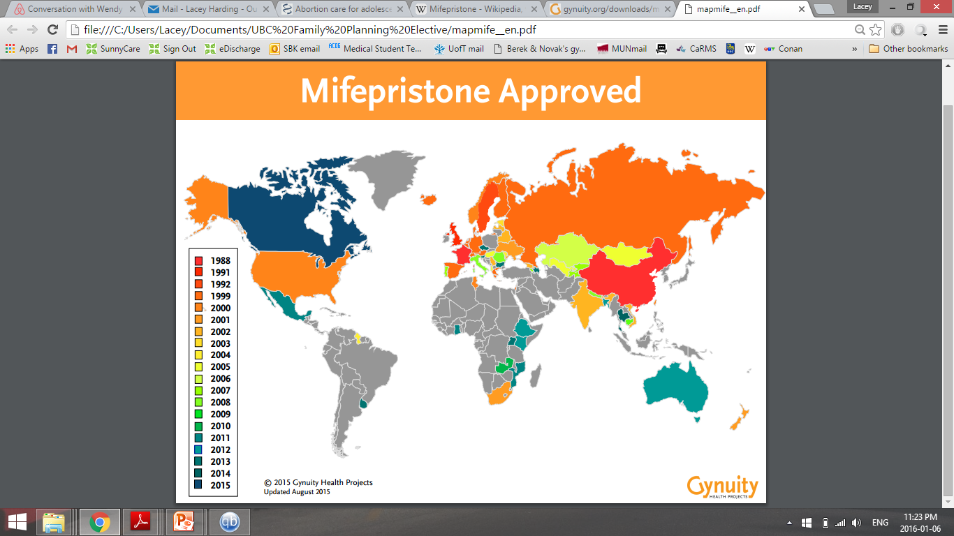

La mifépristone a été approuvée au Canada en 2015
Notes:
Since the 2012 survey there have been significant changes in abortion care in Canada
Mifegymiso approved in Canada 29 July 2015
Changes in professional regulations; allowing NPs to provide medical abortion in some provinces

Slide 7
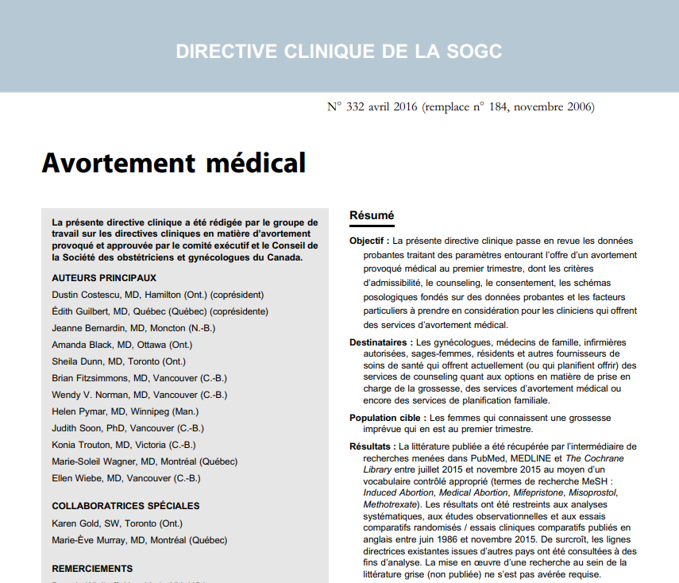
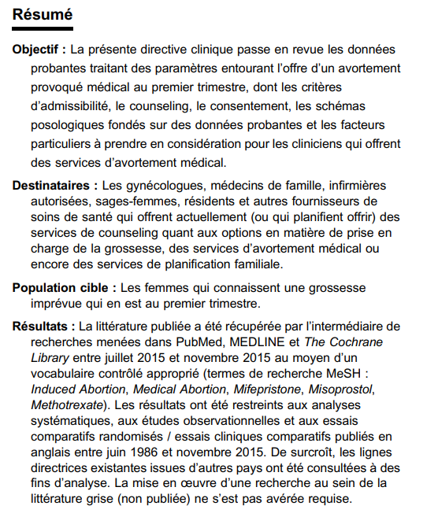
Nouvelle directive clinique
Notes:
3. Clinical guideline changes

Slide 8

directive clinique révisée
Notes:
3. Clinical guideline changes

Slide 9
Question de recherche
Comment les services d'avortement et leur main-d'œuvre sont-ils répartis au Canada, et de quelle façon la qualité des soins a-t-elle changé depuis 2012, particulièrement depuis l'introduction de la mifépristone en 2017 et la publication des nouvelles directives cliniques?
Notes:
Research question
How are abortion services and workforce distributed and how has quality of care changed in Canada since 2012, particularly in relation to the 2017 introduction of mifepristone and to publication of new SOGC guidelines?

Slide 10
objectifs
Documenter l'évolution des caractéristiques et de la répartition de la main-d'œuvre en soins d'avortement de 2012 à 2019;
Évaluer la qualité des soins, c.-à-d. les caractéristiques des pratiques d'avortement médical et chirurgical rapportées par les participant(e)s par rapport à celles des directives cliniques canadiennes révisées
Déterminer dans quelle mesure les fournisseur(-euse)s d’avortement sont victimes de harcèlement et de stigmatisation dans le cadre de leur travail et explorer leur résilience
Notes:
Research question
How are abortion services and workforce distributed and how has quality of care changed in Canada since 2012, particularly in relation to the 2017 introduction of mifepristone and to publication of new SOGC guidelines?

Slide 11
Méthode
Enquête transversale nationale en ligne pour l’année 2019
Critères d’inclusion:
Être un médecin ou un(e) infirmier(-ière) praticien(ne) spécialisé(e) qui fournit des soins d’avortement et qui a terminé sa formation professionnelle (école, résidence, stage postdoctoral « fellowship »)
OU
Être un(e) administrateur(-trice) de services d'avortement tel(le) que directeur(- trice) de programme, directeur(-trice) médical(e) ou directeur(-trice) des opérations
Notes:
We invite subjects meeting all of the following inclusion criteria to participate in the study:
Health care professionals (physicians, NPs, RNs, midwives) providing abortion care who have completed their professional training (school, residency, fellowship)
Abortion service administrators (such program manager or medical director or operation leads)
AND
having provided abortion care in 2019, as described below:
having prescribed at least one first trimester medical abortion functioning as either an independent MRP (most responsible provider), under medical directive or with physician collaborative agreement
OR
having performed at least one surgical abortion
OR
having provided at least one second or third trimester medical abortion functioning as an independent MRP (most responsible provider)
OR
providing administrative support for abortion services
AND
providing abortion care for a live embryo/fetus/pregnancy rather than managing a miscarriage or intrauterine fetal demise
AND
Able to read and write in English or French
To which degree do we need to explain how inclusive this will be?

Slide 12
Critères d’inclusion (suite)
ET
Avoir fourni des soins d’avortement pour un embryon/fœtus/grossesse vivant(e), en 2019, comme décrit ci-dessous:
  avoir prescrit au moins un avortement médical du premier trimestre en tant que professionnel(le) le (la) plus responsable de façon indépendante
  OU
  avoir fourni au moins un avortement chirurgical en tant que professionnel(le) le (la) plus responsable de façon indépendante
  OU
  avoir fourni au moins un avortement médical du deuxième ou troisième trimestre en tant que professionnel(le) le (la) plus responsable de façon indépendante
  OU
  avoir fourni un soutien administratif pour les services d'avortement
  Être capable de lire et d'écrire l’anglais ou le français
ET

Slide 13
QUESTIONNAIRE
Section 1 Caractéristiques démographiques (5 min)
Section 2 Pratiques cliniques d'avortement: Avortement médical du premier trimestre (15 min)
Avortement chirurgical du premier trimestre (15 min)
Avortement chirurgical du deuxième trimestre (15 min)
Avortement médical du deuxième/troisième trimestre (induction du travail) (10 min)
Section 3 Administrateur(-trice)s (10 min)
Section 4 Populations diverses (5 min)
Section 5 Stigmatisation et résilience (expériences en tant que clinicien(ne) ou administrateur(-trice)) (5 min) Section 6 Rémunération et recherches futures (1 min)
Tous les participants et toutes les participantes seront invité(e)s à compléter les sections 1, 4, 5 et 6. Les clinicien(ne)s devront compléter la section 2. Plus la gamme des soins d’avortement fournie par un(e) participant(e) est étendue (couverte dans la section 2), plus il faudra de temps pour compléter le questionnaire. Les administrateur(-trice)s seront invité(e)s à compléter la section 3 au lieu de la section 2.
Notes:
We started with a revision of the 2012 survey instrument
We held 7 expert group meetings and revised each clinical section and developed questions for midwives and nurses.
Survey instrument online in redcaps
Participants will only see the questions that apply to the services that you indicate you are providing.

Slide 14







Recrutement
Notes:
One of the challenges will be to identify all health care professionals providing abortion care in Canada. And in fact we do not know the denominator. We aim to include health care professionals who provide e.g. medical abortion as part of their general practice, maternal fetal medicine specialists who provide 2nd /3rd trimester medical abortion, /labour induction, nurses and midwives all of whom might not consider themselves explicitly as “abortion providers” and hence will not be members of abortion related organizations such as NAF. We further aim to recruit the physicians who consider themselves more explicitly as abortion providers and who will be easier to reach through organizations such as NAF or Action Canada. We therefore are collaborating with multiple professional organizations some of which are shows on this slide, who we have asked to advertise our survey link to their membership via email, internet or conferences, etc.
College of Family Physicians Canada (CFPC)
CFPC Québec Branch
Divisions of Family Practice
Society of Obstetricians and Gynaecologists (SOGC)
Maternal Fetal Medicine Program at Sunnybrook Research Institute
Society of Family Planning
Comité de vigilance sur l'avortement, la Fédération du Québec pour le planning des naissances (FQPN)
Association des obstétriciens et gynécologues du Québec (AOGQ)
Committee of experts in family planning at the National Institute of Public Health of Quebec (NSPQ)
Canadian Association of Midwives (CAM)
Action Canada for Sexual Health & Rights
Nurse Practitioner Association of Canada (NPAC)
Provincial NP Associations
NP Association of Ontario (NPAO)
RN Association of Ontario (RNAO)
College of Nurses of Ontario
Canadian Nurses Association (CNA)

Slide 15
ÉCHÉANCIER (subvention de 4 ans)
Jan 2019 Subvention des IRSC accordée
Mar – Nov 2019 Préparation du questionnaire, incluant plusieurs réunions d'experts
Déc 2019 Approbation du Comité d’éthique de la recherche
2019 - en cours Établir des relations avec des partenaires de recrutement
Déc 2019 – Jan 2020 Phase pilote du questionnaire en anglais dans REDCap
Traduction du questionnaire en français
Jan – Fév 2020 Phase pilote du questionnaire en français dans REDCap
Fév – Juillet 2020 Révision des questionnaires
Août 2020 Déploiement du questionnaire
2021 Analyse des données et activités d'application des connaissances
2022 Activités d'application des connaissances
Notes:
Examples of KT in clinical research:
• Creating up-to-date systematic reviews or other syntheses of global evidence
• Communications/collaborations with researchers in other disciplines and pillars
• Consultation with biomedical researchers about the results of clinical trials
• Plain language summaries directed at main stream media
• Consultation/collaboration with patients in the development of research questions
Examples of KT in Health Services Research:
• Engaging research users in the planning, implementation and evaluation of research
• Connecting with policy makers
• Creating media releases
• Co-creating with research users KT products (videos, articles, reports, and websites) designed to engage the public in the research products or results.

Slide 16


remerciements
Notes:
One of the challenges will be to identify all health care professionals providing abortion care in Canada. And in fact we do not know the denominator. We aim to include health care professionals who provide e.g. medical abortion as part of their general practice, maternal fetal medicine specialists who provide 2nd /3rd trimester medical abortion, /labour induction, nurses and midwives all of whom might not consider themselves explicitly as “abortion providers” and hence will not be members of abortion related organizations such as NAF. We further aim to recruit the physicians who consider themselves more explicitly as abortion providers and who will be easier to reach through organizations such as NAF or Action Canada. We therefore are collaborating with multiple professional organizations some of which are shows on this slide, who we have asked to advertise our survey link to their membership via email, internet or conferences, etc.
College of Family Physicians Canada (CFPC)
CFPC Québec Branch
Divisions of Family Practice
Society of Obstetricians and Gynaecologists (SOGC)
Maternal Fetal Medicine Program at Sunnybrook Research Institute
Society of Family Planning
Comité de vigilance sur l'avortement, la Fédération du Québec pour le planning des naissances (FQPN)
Association des obstétriciens et gynécologues du Québec (AOGQ)
Committee of experts in family planning at the National Institute of Public Health of Quebec (NSPQ)
Canadian Association of Midwives (CAM)
Action Canada for Sexual Health & Rights
Nurse Practitioner Association of Canada (NPAC)
Provincial NP Associations
NP Association of Ontario (NPAO)
RN Association of Ontario (RNAO)
College of Nurses of Ontario
Canadian Nurses Association (CNA)

Slide 17
Équipe de recherche
Chercheures principale:
Regina Renner, MD, MPH, FRCSC, FACOG, Professeure agrégée de clinique, Département d'obstétrique-gynécologie, University of British Columbia
regina.renner@ubc.ca

Slide 18
cochercheurs
Jon Barrett, MBBch, FRCOG, MD, FRCSC, University of Toronto
Madeleine Ennis, PhD, Postdoctoral Fellow, University of British Columbia
Stephanie Begun, PhD, MSW, RSW, University of Toronto
Melissa Brooks, MD, FRCSC, Dalhousie University
Denise Bryant-Lukosius, RN, CON(C), BScN, MScN, PhD, McMaster University
Damien Contandriopoulos, BSc, MSc, PhD, University of Victoria
Elizabeth Darling, BArtsSc (Hons), BHSc, MSc, PhD, McMaster University
Brigid Dineley, MD, MHS, FRCSC, University of British Columbia
Sheila Dunn, MD, MSc, CCFP (EM), FCFP, University of Toronto
Roopan Gill, MD, MPH, FRCSC, University of British Columbia
Edith Guilbert, MD, MSc, Laval University
Janusz Kaczorowski, MA, PhD, University of Montreal
Ruth Martin-Misener, NP, PhD, Dalhousie University
Kim McGrail, MPH, PhD, University of British Columbia
Sarah Munro, PhD, University of British Columbia
Wendy Norman, MD, FCFP, DTM&H, MHSc, University of British Columbia
Helen Pymar, MD, FRCSC, MPH, University of Manitoba
Notes:
Multidisciplinary and national Co-I team

Slide 19
Cette enquête est maintenant terminée
Le sondage a été mené entre juin et décembre 2020. L'analyse des données est en cours (500 réponses).

